Slide 1

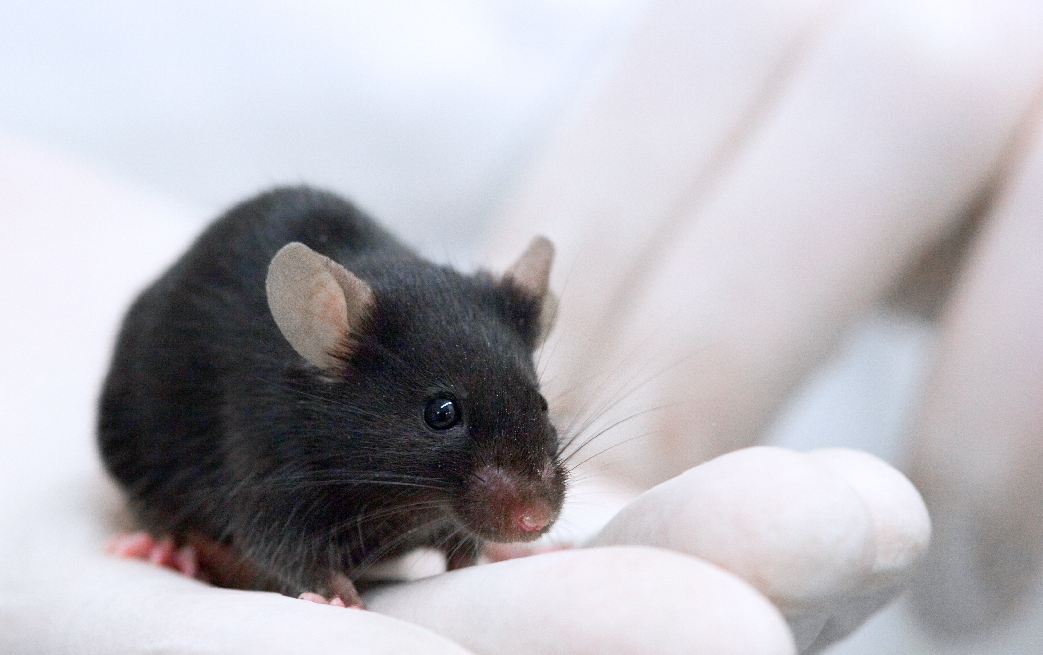

Streamlines data collection so you can focus on results
Rodent Activity Companion
Log In
Sign Up

